Slide 1
Help Wanted Online A real-time measure of job postings
April 2022
Office of Research Connecticut Department of Labor
Connecticut Department of Labor – Research Office 200 Folly Brook Blvd. Wethersfield, CT 06109
Help Wanted Online

Slide 2
What is HWOL?
The Conference Board Help Wanted Online® Data Series (HWOL) measures the number of new, first-time Online job postings and jobs reposted from the previous month for over 50,000 Internet job boards, corporate boards and smaller job sites that serve niche markets and smaller geographic areas.
Connecticut Department of Labor – Research Office 200 Folly Brook Blvd. Wethersfield, CT 06109
Help Wanted Online

Slide 3
Upcoming Release Dates
Monthly Report: Friday, May 13th, 2022 Weekly New Ads Report: Updated every Friday
Connecticut Department of Labor – Research Office 200 Folly Brook Blvd. Wethersfield, CT 06109
Help Wanted Online

Slide 4
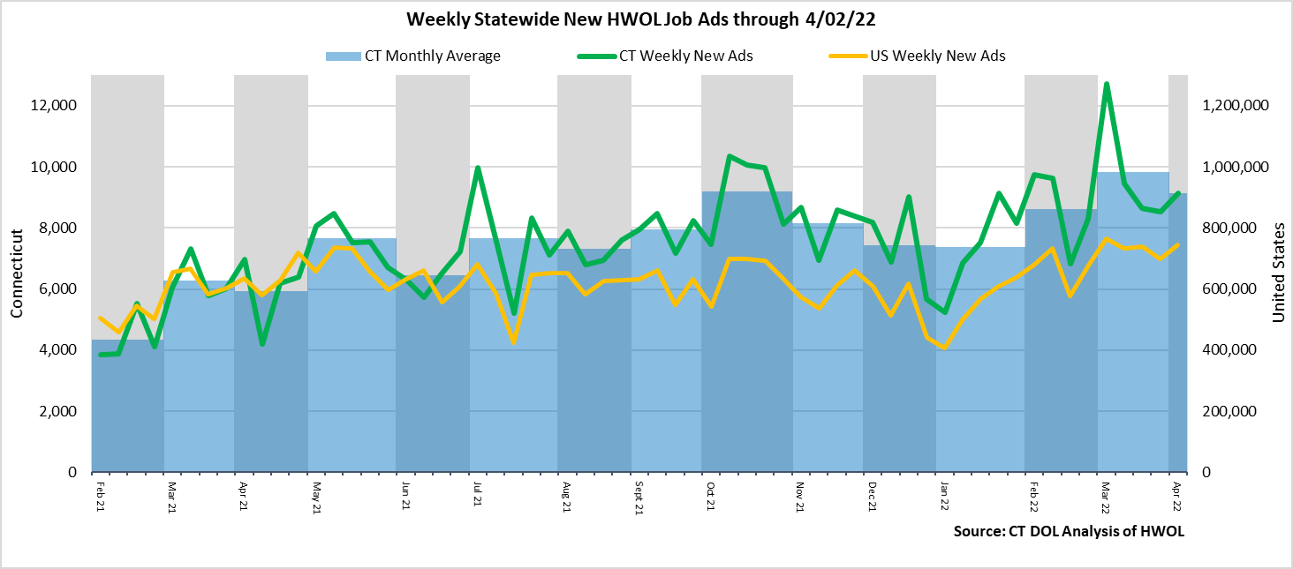
Statewide Weekly New Job Ads
Weekly New job postings was 9,146 during the week ending 4/02/22.
Connecticut Department of Labor – Research Office 200 Folly Brook Blvd. Wethersfield, CT 06109
Help Wanted Online

Slide 5
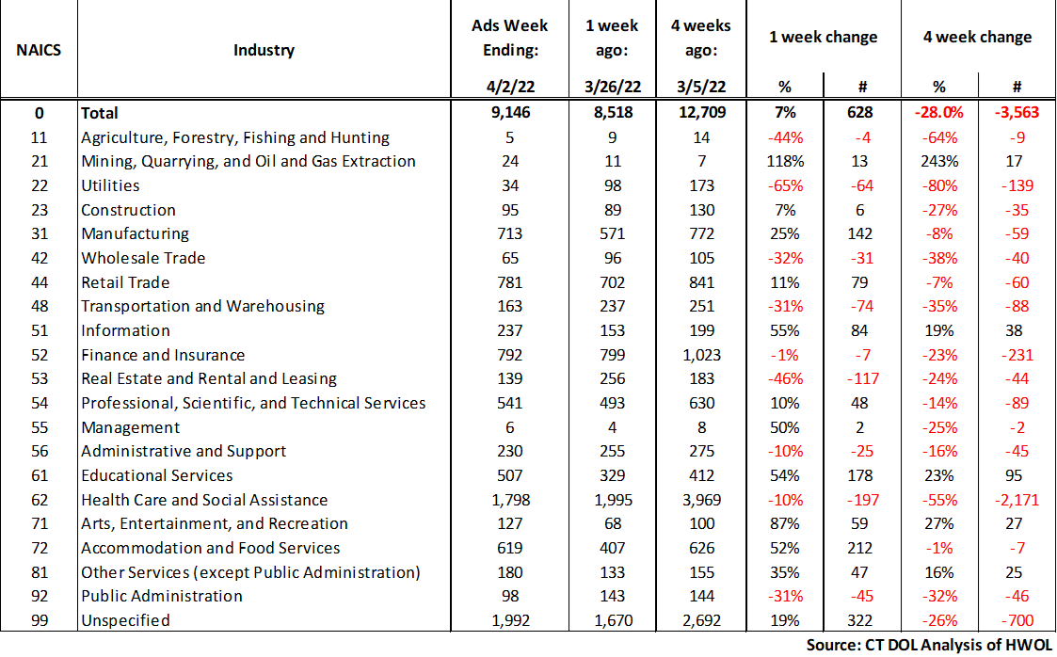
HWOL New Weekly Industry Job Ads – CT Statewide
Connecticut Department of Labor – Research Office 200 Folly Brook Blvd. Wethersfield, CT 06109
Help Wanted Online

Slide 6
Connecticut Department of Labor – Research Office 200 Folly Brook Blvd. Wethersfield, CT 06109
Help Wanted Online

Slide 7
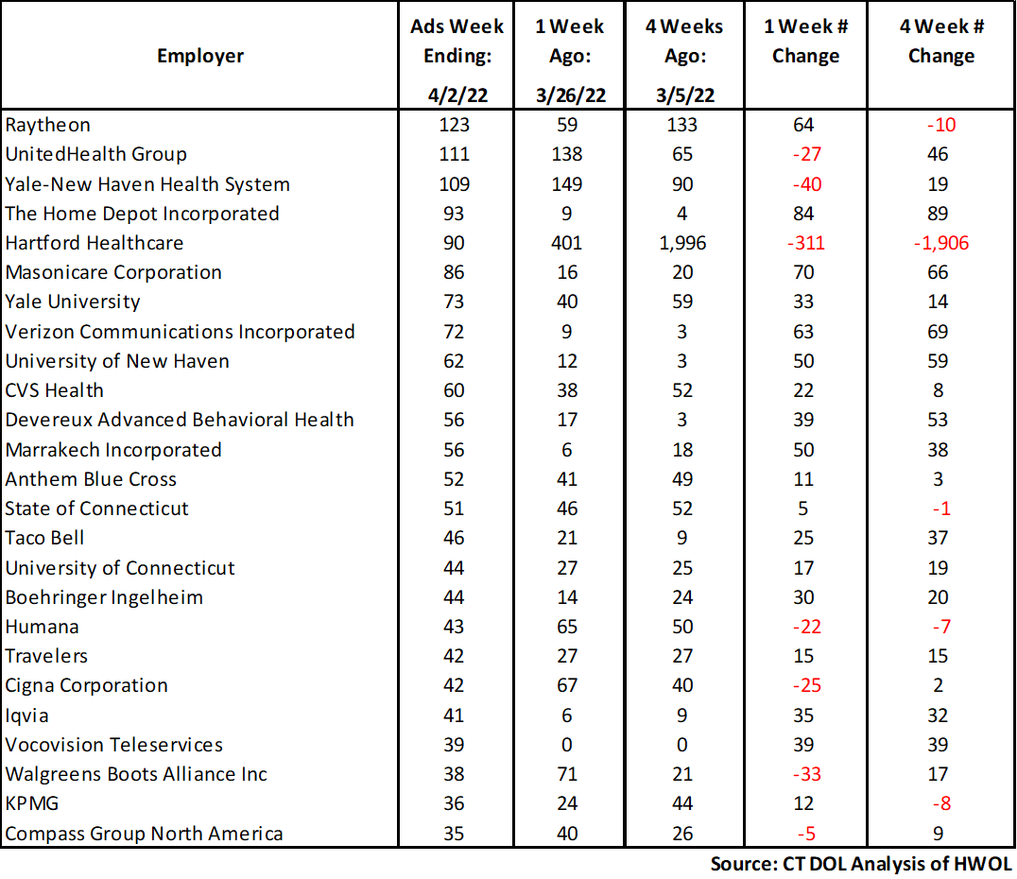
Employers with the Most New Job Postings
Connecticut Department of Labor – Research Office 200 Folly Brook Blvd. Wethersfield, CT 06109
Help Wanted Online

Slide 8
Monthly HWOL Information
The following pages contain HWOL monthly data for March 2022. Monthly and weekly job ad information can be found here: https://www1.ctdol.state.ct.us/lmi/HWOL.asp
Connecticut Department of Labor – Research Office 200 Folly Brook Blvd. Wethersfield, CT 06109
Help Wanted Online

Slide 9
Statewide Highlights
- Total postings in Connecticut was 113,542 in March 2022, up 16% from February 2022. -Industry sectors with the most job postings were Health Care and Social Assistance (26,255 postings), Retail Trade (11,572 postings), Finance and Insurance (9,297 posting), and Manufacturing (8,031 postings).
-Occupations with the most postings were Registered Nurses (9,464 postings), Retail Salespersons (3,041 postings), Wholesale & Manufacturing Sales Representatives (2,477 postings), and Heavy & Tractor-Trailer Truck Drivers (2,435 postings).
Connecticut Department of Labor – Research Office 200 Folly Brook Blvd. Wethersfield, CT 06109
Help Wanted Online

Slide 10
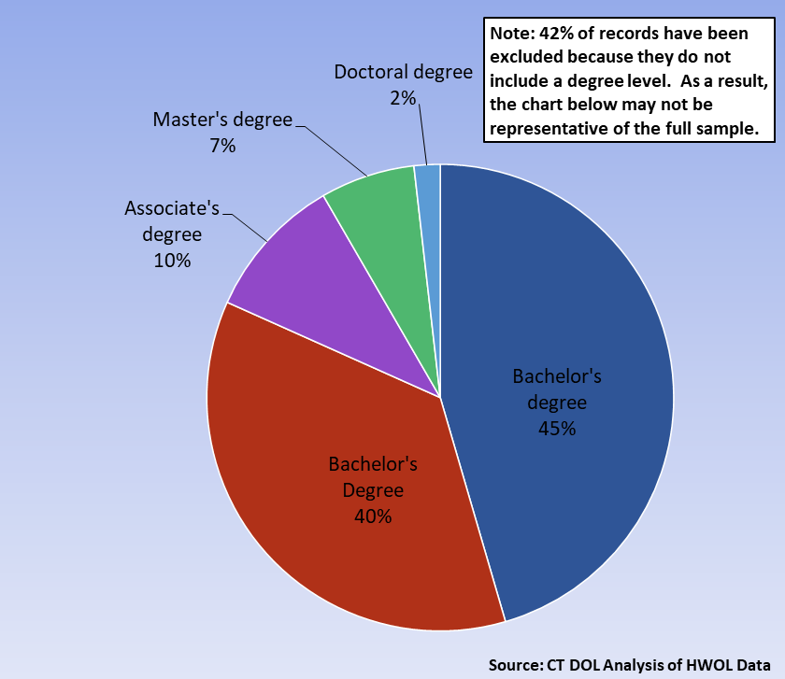
Connecticut Job Ads by Educational Requirements
Connecticut Department of Labor – Research Office 200 Folly Brook Blvd. Wethersfield, CT 06109
Help Wanted Online

Slide 11
Top Certifications in Connecticut Job Ads
Connecticut Department of Labor – Research Office 200 Folly Brook Blvd. Wethersfield, CT 06109
Help Wanted Online

Slide 12
Top Skills in Connecticut Job Ads
Connecticut Department of Labor – Research Office 200 Folly Brook Blvd. Wethersfield, CT 06109
Help Wanted Online

Slide 13
Top Skills by Industry in Connecticut Job Ads
Connecticut Department of Labor – Research Office 200 Folly Brook Blvd. Wethersfield, CT 06109
Help Wanted Online

Slide 14
Top Skills by Industry in Connecticut Job Ads (Continued)
Connecticut Department of Labor – Research Office 200 Folly Brook Blvd. Wethersfield, CT 06109
Help Wanted Online

Slide 15
Connecticut Department of Labor – Research Office 200 Folly Brook Blvd. Wethersfield, CT 06109
Help Wanted Online

Slide 16
Connecticut Employers with the Most Job Ads
Connecticut Department of Labor – Research Office 200 Folly Brook Blvd. Wethersfield, CT 06109
Help Wanted Online

Slide 17
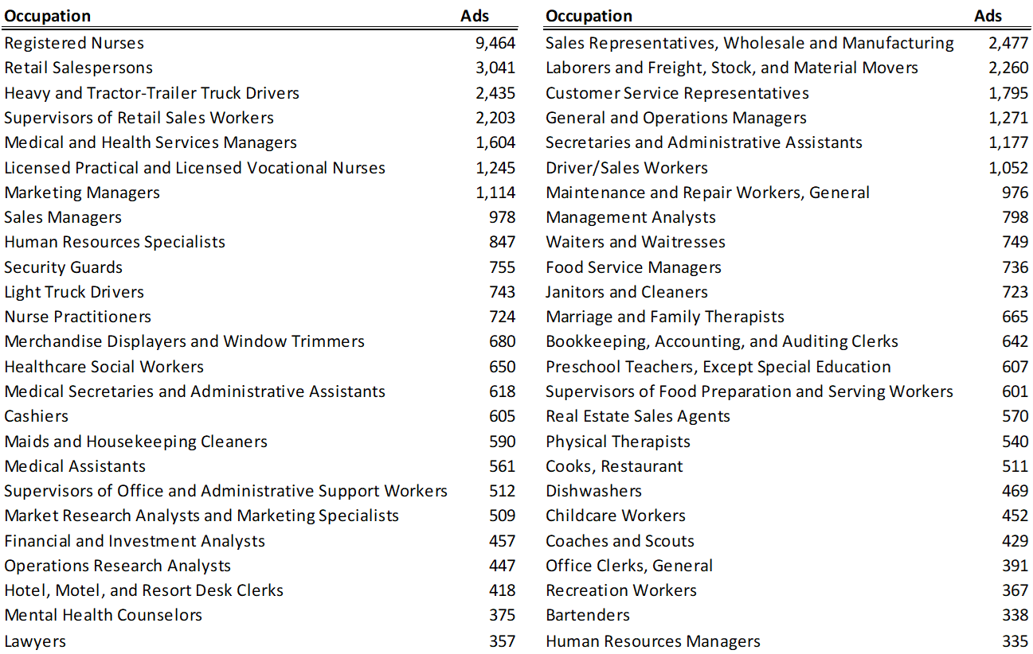
Connecticut Occupations with the Most Job Ads
Connecticut Department of Labor – Research Office 200 Folly Brook Blvd. Wethersfield, CT 06109
Help Wanted Online

Slide 18
Connecticut Job Ads by Industry and Major Occupational Group
Connecticut Department of Labor – Research Office 200 Folly Brook Blvd. Wethersfield, CT 06109
Help Wanted Online

Slide 19
Workforce Area Data
Workforce Area Highlights
Job Ads by Industry
Job Ads by Location
Employers With The Most Job Ads
Occupations With The Most Job Ads
Connecticut Department of Labor – Research Office 200 Folly Brook Blvd. Wethersfield, CT 06109
Help Wanted Online

Slide 20
Workforce Area Highlights
Connecticut Department of Labor – Research Office 200 Folly Brook Blvd. Wethersfield, CT 06109
Help Wanted Online

Slide 21
Connecticut Department of Labor – Research Office 200 Folly Brook Blvd. Wethersfield, CT 06109
Help Wanted Online

Slide 22
Eastern Workforce Job Ads by Location
Connecticut Department of Labor – Research Office 200 Folly Brook Blvd. Wethersfield, CT 06109
Help Wanted Online

Slide 23
Eastern Workforce Employers
with the Most Job Ads
University of Connecticut
Mohegan Sun
Pfizer
Hartford Healthcare
Day Kimball Healthcare
State of Connecticut
Healthpro Heritage
HHM
Charles River Laboratories
CVS Health
Generations Family Health Center
Lowe's Companies, Inc
Walmart / Sam's
Groton Public Schools
Girl Scouts Of Connecticut
Rogers Corporation
UnitedHealth Group
Aveanna Healthcare
PepsiCo Inc.
General Dynamics
Yale-New Haven Health System
Masonicare Corporation
Staples
Mashantucket Pequot Gaming
Windham Hospital
Compass Group North America
Walgreens Boots Alliance Inc
Mitchell College
US Foods
Norwich Public Schools
BJ's Wholesale Club, Inc.
Hilton Hotel Corporation
Spirol International Corporation
Greater Hartford YMCA
Allied Universal
Asplundh Tree Expert Company
Dattco
Nordson Corporation
Connecticut Department of Labor – Research Office 200 Folly Brook Blvd. Wethersfield, CT 06109
Help Wanted Online

Slide 24
Eastern Workforce Occupations
with the Most Job Ads
Connecticut Department of Labor – Research Office 200 Folly Brook Blvd. Wethersfield, CT 06109
Help Wanted Online

Slide 25
Connecticut Department of Labor – Research Office 200 Folly Brook Blvd. Wethersfield, CT 06109
Help Wanted Online
25

Slide 26
North Central WDA Job Ads by Location
Connecticut Department of Labor – Research Office 200 Folly Brook Blvd. Wethersfield, CT 06109
Help Wanted Online

Slide 27
North Central WDA Employers
with the Most Job Ads
Amazon
Cigna Corporation
UnitedHealth Group
Travelers
Accenture
State of Connecticut
Disney
CVS Health
Carvana LLC
Allied Universal
Walgreens Boots Alliance Inc
PricewaterhouseCoopers
Greater Hartford YMCA
Pearson
Bank of America
The Home Depot Incorporated
Lincoln Financial Group
New Britain General
Connecticut Children's Medical Center
Hartford Healthcare
Raytheon
Aya Healthcare
ECHN
The Hartford Financial Group
Wheeler Clinic
EverSource
KPMG
Gopuff Joveo Programmatic
University of Connecticut
Whole Foods Market, Inc.
Eastern Connecticut Health Network
Sysco Corporation
Trinity Health
Superior Plus Trucking
Boston Market
Genesis Healthcare Corporation
Aptask
The Travelers Companies
Connecticut Department of Labor – Research Office 200 Folly Brook Blvd. Wethersfield, CT 06109
Help Wanted Online

Slide 28
North Central WDA Occupations
with the Most Job Ads
Connecticut Department of Labor – Research Office 200 Folly Brook Blvd. Wethersfield, CT 06109
Help Wanted Online

Slide 29
Connecticut Department of Labor – Research Office 200 Folly Brook Blvd. Wethersfield, CT 06109
Help Wanted Online

Slide 30
Northwest WDA Job Ads by Location
Connecticut Department of Labor – Research Office 200 Folly Brook Blvd. Wethersfield, CT 06109
Help Wanted Online

Slide 31
Northwest WDA Employers
with the Most Job Ads
Amazon
Monterey Institute Of International Studies
Trinity Health
Post University
Superior Plus Trucking
Clean Harbors
State of Connecticut
CVS Health
BJ's Wholesale Club, Inc.
United Parcel Service Incorporated
Benchmark Senior Living
Realogy Franchise Group LLC
Walgreens Boots Alliance Inc
TJX Companies, Inc.
Walmart / Sam's
AutoZone Auto Parts
Applied Materials
CDM Smith
Hartford Healthcare
Boehringer Ingelheim
Nuvance Health
Waterbury Hospital
Gopuff Joveo Programmatic
Aya Healthcare
Department Administrative Services
Carvana LLC
UnitedHealth Group
Avangrid
Compass Group North America
Fuelcell Energy Inc
Whole Foods Market, Inc.
Starbucks Coffee Company
Dymax Corporation
The Home Depot Incorporated
LHC Group
Taco Bell
Seasons Hospice & Palliative Care
Connecticut Department of Labor – Research Office 200 Folly Brook Blvd. Wethersfield, CT 06109
Help Wanted Online

Slide 32
Northwest WDA Occupations
with the Most Job Ads
Connecticut Department of Labor – Research Office 200 Folly Brook Blvd. Wethersfield, CT 06109
Help Wanted Online

Slide 33
Connecticut Department of Labor – Research Office 200 Folly Brook Blvd. Wethersfield, CT 06109
Help Wanted Online

Slide 34
South Central WDA Job Ads by Location
Connecticut Department of Labor – Research Office 200 Folly Brook Blvd. Wethersfield, CT 06109
Help Wanted Online

Slide 35
South Central WDA Employers
with the Most Job Ads
Yale-New Haven Health System
Yale University
Anthem Blue Cross
Aya Healthcare
Totalmed Incorporated
Alexion Pharmaceuticals
UnitedHealth Group
Middlesex Health System Incorporated
Walgreens Boots Alliance Inc
Marrakech Incorporated
Raytheon
Taco Bell
Carvana LLC
Department of Veterans Affairs
Lowe's Companies, Inc
Midstate Medical Center
Wesleyan University
A R Mazzotta Employment
Walmart / Sam's
Hartford Healthcare
Amazon
Gopuff Joveo Programmatic
Avangrid
Medtronic
Masonicare Corporation
State of Connecticut
Marrakech
Genesis Healthcare Corporation
Superior Plus Trucking
Quinnipiac University
Arrow Electronics
Gaylord Hospital
CVS Health
AutoZone Auto Parts
Page Taft Compass
The Home Depot Incorporated
Michaels Arts and Crafts
Allied Universal
Connecticut Department of Labor – Research Office 200 Folly Brook Blvd. Wethersfield, CT 06109
Help Wanted Online

Slide 36
South Central WDA Occupations
with the Most Job Ads
Connecticut Department of Labor – Research Office 200 Folly Brook Blvd. Wethersfield, CT 06109
Help Wanted Online

Slide 37
Connecticut Department of Labor – Research Office 200 Folly Brook Blvd. Wethersfield, CT 06109
Help Wanted Online

Slide 38
Southwest WDA Job Ads by Location
Connecticut Department of Labor – Research Office 200 Folly Brook Blvd. Wethersfield, CT 06109
Help Wanted Online

Slide 39
Southwest WDA Employers
with the Most Job Ads
Amazon
Yale-New Haven Health System
Charter Communications
Hartford Healthcare
Gopuff Joveo Programmatic
Stamford Hospital
Compass Group North America
PricewaterhouseCoopers
Whole Foods Market, Inc.
Avangrid
Coopersurgical
Town of Greenwich
Jewish Senior Services
Sacred Heart University
Sunrise Senior Living, Inc.
Array
UnitedHealth Group
CVS Health
Bank of America
Capital One
Humana
Lockheed Martin Corporation
Aya Healthcare
KPMG
Vmware Incorporated
Norwalk Public School District
ASML Holding N V
Totalmed Incorporated
Synchrony
Griffin Health Services Corporation
NBC
Gartner Incorporated
Norwalk Public Schools
Allied Universal
Hubbell Incorporated
Griffin Hospital
The Home Depot Incorporated
Superior Plus Trucking
Connecticut Department of Labor – Research Office 200 Folly Brook Blvd. Wethersfield, CT 06109
Help Wanted Online

Slide 40
Southwest WDA Occupations
with the Most Job Ads
Connecticut Department of Labor – Research Office 200 Folly Brook Blvd. Wethersfield, CT 06109
Help Wanted Online

Slide 41
All advertisement data used in this publication is from the Conference Board’s Help Wanted Online data series.
For more information or data requests, contact Matthew Krzyzek in the Office of Research at the Department of Labor.
Matthew.Krzyzek@ct.gov
For more Connecticut Labor Market Information visit:
www.ctdol.state.ct.us/lmi
https://www.facebook.com/ctlmi
Twitter: @DOL_Research
Connecticut Department of Labor – Research Office 200 Folly Brook Blvd. Wethersfield, CT 06109
Help Wanted Online

